Slide 1
Predictive Models
Iaroslav Shcherbatyi

Slide 2
Agenda
What is predictive modeling and what its purpose is?
How to perform predictive model selection?
Aspects and take-aways on predictive models: overfitting, missing information
Some predictive model classes:
Linear models
K Nearest Neighbors
Kernel Support Vector Machines
Decision trees

Slide 3
What is predictive model
Predictive model is a black box that establishes the relationship between explanatory variables and predicted variables:
Humans constantly build models about reality.
Predictive model
X
Y
The name is misleading: such models can apply to past, present and future.
Predictive models are more useful than random guessing.

Slide 4
A formal setup: dataset
The task of predictive data modelling is to extract and analyze predictive models from existing data (observations of reality).
Set of such observations is called a dataset.

Slide 5
Example dataset
Age | Gender | Pain type | Blood pressure | Oldpeak | Sick
70 | 1 | 4 | 130 | 2.4 | yes
67 | 0 | 3 | 115 | 1.6 | no
57 | 1 | 2 | 124 | 0.3 | yes
64 | 1 | 4 | 128 | 0.2 | no
74 | 0 | 2 | 120 | 0.2 | no
65 | 1 | 4 | 120 | 0.4 | no
56 | 1 | 3 | 130 | 0.6 | yes
59 | 1 | 4 | 110 | 1.2 | yes
60 | 1 | 4 | 140 | 1.2 | yes
63 | 0 | 4 | 150 | 4 | yes
59 | 1 | 4 | 135 | 0.5 | no

Slide 6


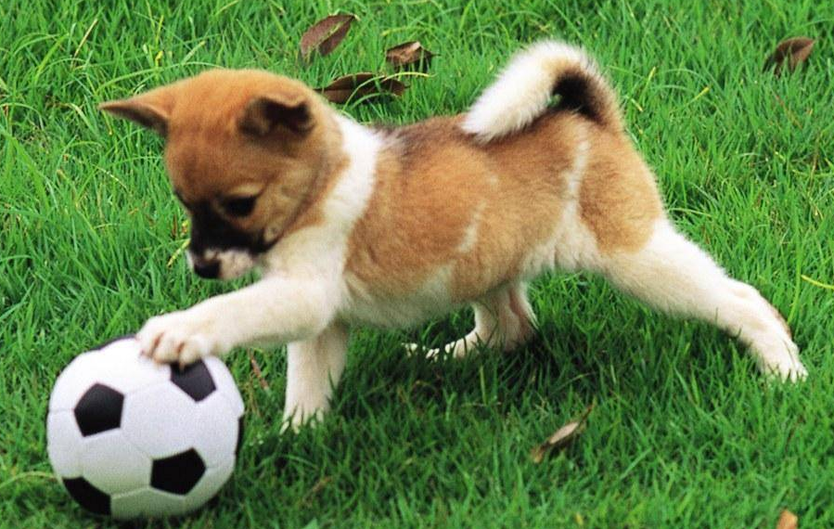
Example dataset
Image | Caption
 | A car driving near the forest
 | People playing Frisbee on the beach
 | A dog playing with a soccer ball

Slide 7
A formal setup: dataset
Dataset is represented as n instances of inputs and outputs.
Separate inputs are generally denoted as x and outputs as y.
All available inputs and outputs are denoted as X and Y.
All possible inputs and outputs are denoted in this lecture as X* and Y*.
Predictive model
X
Y

Slide 8
Model fitting
How to define a model?
How to compare different models?
How to perform a model search?

Slide 9
Model parameters
Predictive model is a function of the form
Every model is defined by a set of its paramters
Example: For linear model, parameters is some vector of the length n:
Set of all such vectors defines the set of all parameters.

Slide 10
Model fitting
How to define a model?
How to compare different models?
How to perform a model search?

Slide 11
Model fitting: model error
Assume we have two models, f₁ and f₂. How to choose between two?
y
f₁
f₂
x

Slide 12
Model fitting: model error
Regression fitting problem: outputs of the model are real numbers.
Loss function: measures how good the fitted function aligns with data.
(e.g., least squares for regression)
y
x

Slide 13
Model fitting: model error
Binary classification problem: model output is binary (e.g. sick / healthy).
Loss function for binary classification: misclassification rate.
y
x

Slide 14
Model fitting
How to define a model?
How to compare different models?
How to perform a model search?

Slide 15
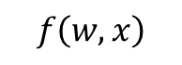
Model search?
Loss function:
Model function:
y
$$f\left(w,x\right)$$
x

Slide 16
Model search
Solve
Using brute force, gradient descent or your favorite heuristic
y
$$f\left(w,x\right)$$
x

Slide 17
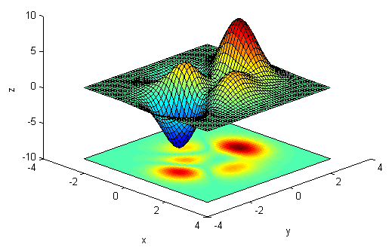
Gradient Descent
Algorithm Gradient Descent
w₁
w₂
stepsize
gradient
Hyperparameters: stepsize η and iterations T
(e.g., η=0.1 and T=100)

Slide 18
Which model is better?
y
f₃
f₂
f₁
x

Slide 19
Which model is better?
y
f₄
x

Slide 20
Avoiding overfitting
The “best” model is the one that has the smallest loss (error) on unseen data.
As unseen data is not available, such error can be approximated with training validation test split of all available data.
All data
y
Training
Validation
f₂
f₄
f₁
Testing
x

Slide 21
Complexity control
Which of the models do you expect to have a better performance on a test set?
y
f₁
f₂
x

Slide 22
Complexity control
Complexity control: explicit – e.g. number of neurons in neural network
Complexity control: using compexity function
L₂ complexity function: smooth model outputs;
L₁ complexity function: smooth model outputs + sparse model parameters.

Slide 23
Complexity control
Loss
Test
Underfitting
Overfitting
Train
complexity

Slide 24

Fundamental limitations
Predictive model is good to the extend to which the data is good.
What is shown on this image?

Slide 25
Fundamental limitations
Predictive model is good to the extend to which the data is good.

Slide 26
Fundamental limitations
Predictive model is good to the extend to which the data is good.
Predict who is a student
Eye color | Blood type | Is student
Green | 1 | ?
Brown | 2 | ?
Green | 1 | ?
Blue | 2 | ?
Brown | 1 | ?

Slide 27

Fundamental limitations
Predictive model is good to the extend to which the data is good.
Robust bcrypt hashing
Unencrypted

Slide 28
Fundamental limitations
Predictive model is good to the extend to which the data is good.
Simple
Complex
Type 1 | Type 2 | Type 3 | Type 4
1 | 0 | 0 | 0
0 | 0 | 1 | 0
0 | 1 | 0 | 0
0 | 0 | 0 | 1
1 | 0 | 0 | 0
Blood type
1
3
2
4
1

Slide 29
Hands on
Workstation in the cloud!
In order to obtain your instance, use this:
-:- coming soon!
Sources: https://github.com/iaroslav-ai/SummerSchool2016

Slide 30
Predictive models
Linear models
K Nearest Neighbors
Kernel Support Vector Machines
Decision trees

Slide 31
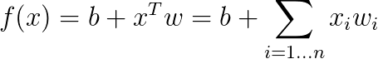
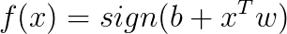
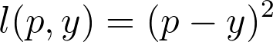
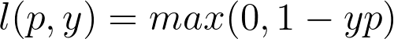
Linear models
Definition of the model:
For regression:
For binary classification:
Loss functions typically used:
Mean squared error, for regression:
Hinge loss, for binary classification:

Slide 32
Linear models: example
Regression
Classification
y
x₂
x₁
x₁

Slide 33
Linear models: pros and cons
Pros:
Best fitting set of parameters can be found in polynomial time
Easy to interpret
Fast evaluation
Cons:
Low modelling power – assumes linear dependency between inputs and outputs.

Slide 34
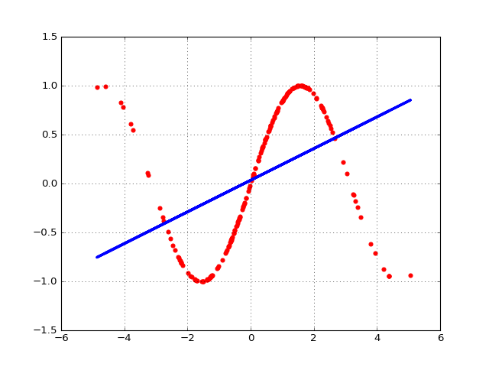
Linear models: limitations
Regression

Slide 35
Linear models: limitations
Classification
x₂
?
x₁

Slide 36
K Nearest Neighbors: KNN
Classification
x₂
x₁

Slide 37
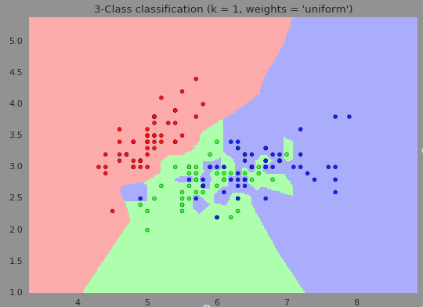
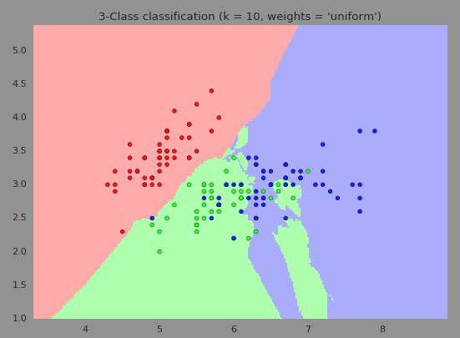
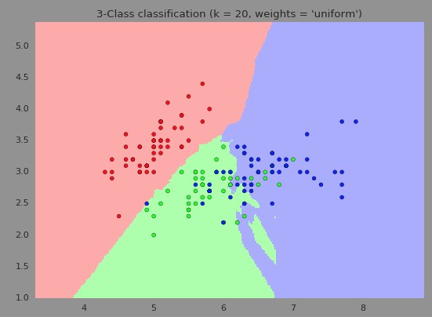
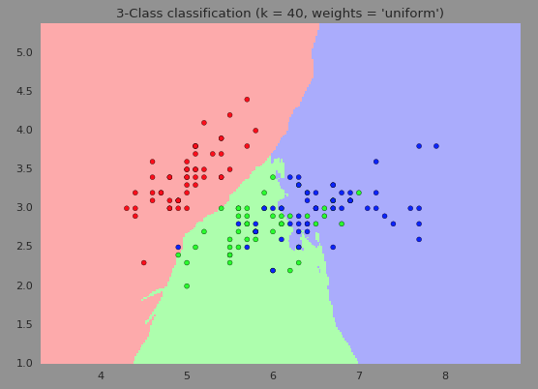
More K – less complex boundary

Slide 38
KNN: pros and cons
Pros:
Can represent non – linear relations
Can be fast for small dimensional features
Cons:
Can be slow for large feature vectors
Requires whole dataset for predictions
Susceptible to noise, for small number of neighbors
Black box model

Slide 39
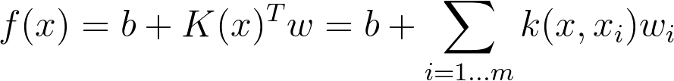
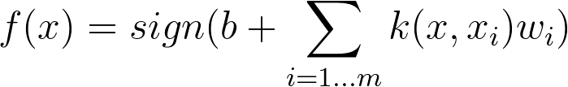
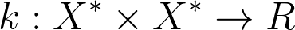
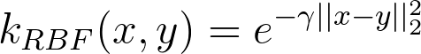
Kernel Support Vector Machines
Definition of the model:
For regression:
For binary classification:
Kernel function:
Kernel function defines similarity or dissimilarity between inputs. It is the function of the form
Kernel function can be defined for images, text, graphs, etc. Usually RBF is used.

Slide 40
Kernel SVM: pros and cons
Pros:
Well studied class of models
Small number of hyperparameters (compared to neural networks)
Clear control over complexity of the model
Cons:
Requires subset of dataset for predictions
Training time grows quadratically with increase of dataset size
Black box model

Slide 41
Decision Trees
Internal nodes: Nodes where the decision branching happens. One feature is tested in every decision node.
Take umbrella?
Raining outside
Is it raining outside?
Leaf nodes: define outputs of the decision process that ends in their branch.
yes
no
Regression task: leaf nodes yield real numbers
Classification task: leaf nodes yield category
Some features might not be used in the decision tree (if they are useless).
Take
Humidity
>0.5
<=0.5
Take
Leave

Slide 42
Decision Trees: pros and cons
Pros:
Well studied for big data
Can capture non – linear dependencies
Can be analyzed and interpreted
Cons:
Performance not as good as for other methods (eg Kernel SVM) in black box setting
Performance depends on training heuristic used

Slide 43
Literature
Hastie, T., Tibshirani, R. „Statistical Learning: Linear regression”, Stanford, 2016, https://lagunita.stanford.edu/c4x/HumanitiesScience/StatLearning/asset/linear_regression.pdf [last downloaded 2016-10-05]
Pfister, H., Blitzstein, J., Kaynig, V. „CS109 Data Science Classification & PCA“, Harvard, 2013
These slides are largely based on slides and material from ‘Introduction into Data Science‘ course taught at the Saarland University.

